Slide 1
Discrete Structure
Unit 4.1 Mathematical Induction

Slide 2
Mathematical Induction
Used to prove statements that P(n) true for all positive integers n, where P(n) is a propositional function
Consists of following steps:
Basis Step: Show P(1) is true.
Inductive Hypothesis: Assume P(k) is true for positive integer k.
Inductive Step: Show that P(k +1) is true on the basis of inductive hypothesis.

Slide 3
Mathematical Induction…
Example
Use mathematical induction to prove that the sum of the first n odd positive integers is n²
Proof: Let P(n) denote the proposition that the sum of the first n odd positive integers is n², that is, 1 + 3 + 5 + … + (2n -1) = n².
Basis Step:
P(1) is true, that is, sum of first odd positive integer is 1², since 1 = 1².
Inductive Hypothesis:
Assume that P(k) is true for a positive integer k. Hence, 1 + 3 + 5 + … + (2k - 1) = k².
Inductive Step:
We have to show that P(k + 1) is true on the basis of inductive hypothesis.
P(k + 1) = 1 + 3 + 5 + … + (2k - 1) + (2k + 1)
= [1 + 3 + 5 + … + (2k - 1)] + (2k + 1)
= k² + (2k + 1) [using induction hypothesis]
= k² + 2k + 1
= (k + 1)²
Hence, P(n) is true for all positive integers.

Slide 4
Mathematical Induction (Exercise)…
Prove that 2 - 2.7 + 2.7² -… +2(-7)^{n} = (1 - (-7)^{n+1})/4 whenever n is a nonnegative integer
Prove that 1.1! + 2.2! + … + n.n! = (n+1)! –1, whenever n is a positive integer
Use mathematical induction to prove that 1 + 2 + 3 + ... + n = n (n + 1) / 2
Prove that 1 ² + 2 ² + 3 ² + ... + n ² = n (n + 1) (2n + 1)/ 6 For all positive integers n.
Use mathematical induction to prove that 1 ³ + 2 ³ + 3 ³ + ... + n ³ = n ² (n + 1) ² / 4
Prove that for any positive integer number n , n ³ + 2 n is divisible by 3
Use the mathematical induction to prove that 3 ^{n} > n ² for n a positive integer greater than 2
Prove that n ! > 2 ^{n} for n a positive integer greater than or equal to 4. (Note: n! is n factorial and is given by 1 * 2 * ...* (n-1)*n.)
Show that n < 2^{n} for all positive integers n.

Slide 5
Strong Induction
Here we assume that P(k) is true for every integer j ≤ k and show that P(k+1) is true based on this assumption
Consists of following steps
Basis Step: Show P(1) is true.
Inductive Hypothesis (Strong): Assume that P(k) is true for every integer j ≤ k.
Inductive Step: Show based on the assumption that P(k+1) is true.

Slide 6
Strong Induction (Example)…
Prove that 3 divides n³ + 2n whenever n is a nonnegative integer.
Proof: Let P(n) = n³ + 2n, then
Basis Step: For n = 1, we have n³ + 2n = 3, this is divisible by 3 hence the statement is true for n = 1.
Inductive Hypothesis: Assume that the P(k) = k³ + 2k is divisible by 3 for every integer j ≤ k.
Inductive Step: here we are going to show that P(k+1) true. We have
P(k+1) = (k+1)³ + 2(k+1)
= k³ +3 k² + 3k + 1 + 2k + 2
= k³ + 2k + 3 k² + 3k + 3
= 3 l + 3 k² + 3k + 3 (since k³ + 2k is divisible by 3)
= 3(l + k² + k + 1)
= 3m
Hence, P(k+1) is divisible by 3. So by mathematical induction n³ + 2n is divisible by three for all nonnegative integers n.

Slide 7
Well Ordering Principle
Every non-empty set of non-negative integers has a least element
Eg Z⁺, here the least element is 1
n ∈ Z⁺, where n ≥4, here the least element is 4
It is important in mathematical induction because we have to prove for the base value
If n ∈ Q (Set of rational numbers), then there is no least element
That means, mathematical element can be implied only to integers

Slide 8
Well Ordering Principle…
Let us assume the following cases in which we are unable to find the smallest number
Set of integers
{……..-3,-2,-1,0,1,2,3,……………}
Set of rational numbers
{1/2,1/3,1/4,………………….}

Slide 9
Well Ordering Principle(Example)…
Use the well ordered property to prove that if a is an integer, b is a positive integer, then there are unique integers q and r with 0≤r<b and a = bq + r (division algorithm)
Proof
Case 1
a is multiple of b, i.e there exist non negative integer q such that a = bq
Now a = bq + r (where r = 0)……..(eq^{n} i)
Case 2
a is not multiple of b

Slide 10

Well Ordering Principle(Example)…
We know that
2b > 1
2ab > a
(2a)b > a
Case 2
a is not multiple of b, and there exist multiple of b greater than a
So by well order property, the set of multiples of b, greater than a has a smallest integer (say q+1)
We can say that qb < a < (q+1)b
Now, taking first two inequalities
qb < a ⇒ a – qb > 0 ⇒ r > 0 [a = bq + r ⇒ r = a - bq]
Now taking last two inequalities
a < (q+1)b ⇒ a < qb + b ⇒a – qb < b ⇒ r < b
That means 0 < r < b
Now a = qb + r , where 0 <r < b ……(eq^{n} ii)
Combining i and ii
We get a = qb + r, 0 ≤ r < b

Slide 11
Well Ordering Principle(Example)…
Proving uniqueness
Let there exist q₁, r₁ and q₂, r₂ such that
a =q₁b + r₁……..(eq^{n} iii)
a = q₂b + r₂…….(eq^{n} iv)
Subtracting iii from iv, we get
0 = (q₂-q₁)b + (r₂-r₁) ⇒ (q₂-q₁)b = (r₂-r₁)……(eq^{n} v)
i.e. r₂-r₁ is multiple of b
Here 0≤r₁< b and 0 ≤r₂<b implies -b < (r₂-r₁)<b…(eq^{n} vi)
From v and vi
r₂ – r₁ = 0 ⇒ q₁ – q₂ = 0 ⇒ q₁ =q₂, and r₁ = r₂
Hence proved

Slide 12
Generalized Induction
is used to prove results about sets other than the integers that have the well-ordering property
For example, consider an ordering on N⨉N, ordered pairs of nonnegative integers. Specify that (x1,y1) is less than or equal to (x2,y2) if either x1< x2, or x1=x2and y1 <y2. This is called the lexicographic ordering

Slide 13
End of Session 4.1

Slide 14
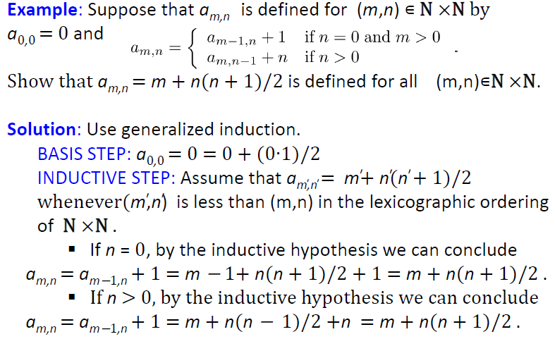
Generalized Induction (Example)…

